Slide 1

Introduction to Network
Computer System Engineering, Fall 2019. (IPADS, SJTU)
As a component, and as a system itself
Yubin Xia

Slide 2
Layers in Network
Application
Can be thought of as a fourth layer
Not part of the network
End-to-end layer
Everything else required to provide a comfortable application interface
Network layer
Forwarding data through intermediate points to the place it is wanted
Link layer
Moving data directly from one point to another

Slide 3
OSI, TCP/IP & Protocol Stack
7th Application Layer
Application Layer
HTTP
SMTP
POP3
FTP
…
End-to-end Layer
6th Presentation Layer
5th Session Layer
4th Transport Layer
Transport Layer
TCP
UDP
3th Network Layer
Network Layer
IP
Network Layer
ICMP
2nd Link Layer
Link Layer
ARP & RARP
Ethernet
PPP
…
Link Layer
1st Physical Layer
WiFi
Fiber
TD-LTE
FDD
…
OSI
TCP/IP
CSE

Slide 4
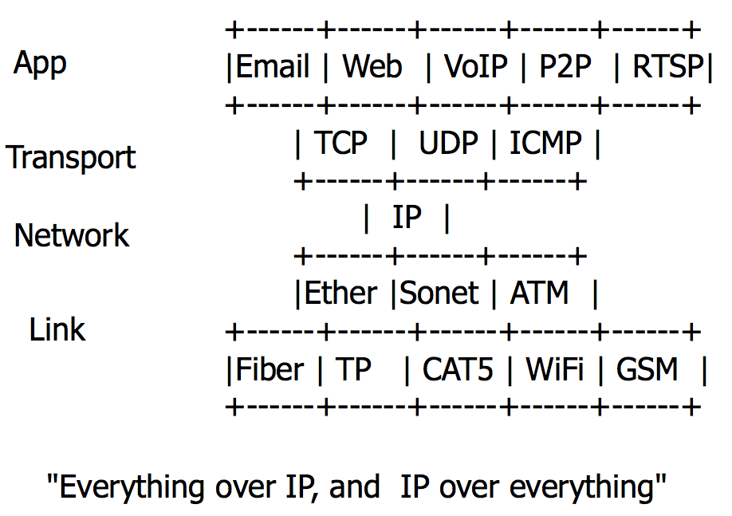
The Internet "Hour Glass" Protocols
More people, more useful
Value to me = N
Value to society is N²
Network, dumb vs. smart
Standardize vs. flexibility
Network is a black box
Simplify the system that uses it
Notes:
The more people that use a network, the more useful it is for everybody.
Value to me is proportional to N people using the same net.
Value to society is proportional to N^2.

Slide 5
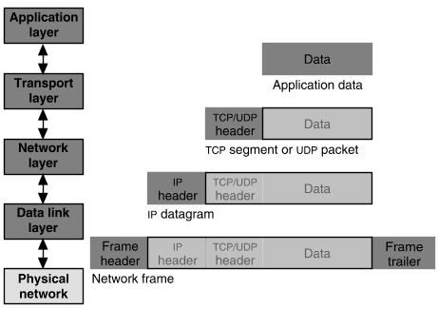
Packet Encapsulation
22Bytes
20Bytes
20Bytes
4Bytes
64 to 1500 Bytes

Slide 6


Application Layer
Entities
Client and server
End-to-end connection
Name space: URL
Protocols
HTTP, FTP, POP3, SMTP, etc.
What to care?
Content of the data: video, text, …
<html>
<head>
<title>Google</title>
<script>window.google=…..
</script>
</head>
<body> … </body>
</html>

Slide 7

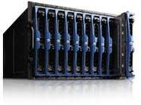
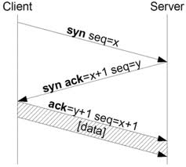
Transport Layer
Entities
Sender and receiver
Proxy, firewall, etc.
End-to-end connection
Name space: port number
Protocols: TCP, UDP, etc.
What to care?
TCP: Retransmit packet if lost
UDP: nothing

Slide 8
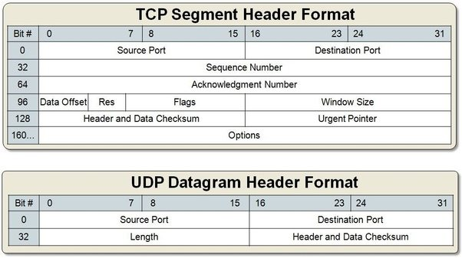
Packet Format of TCP & UDP

Slide 9
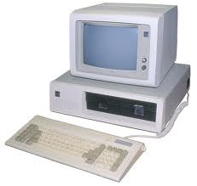
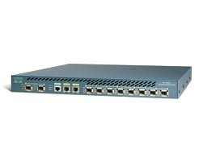
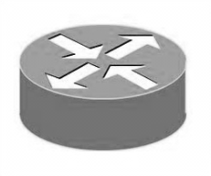
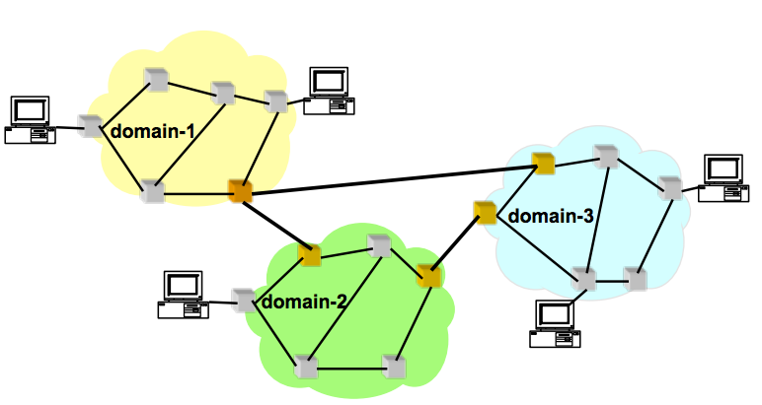
Network Layer (the Internet Layer, IP Layer)
Network entities
Gateway, bridge
Router, etc.
Name space
IP address
Protocols
IP, ICMP (ping)
What to care?
Next hop decided by route table

Slide 10
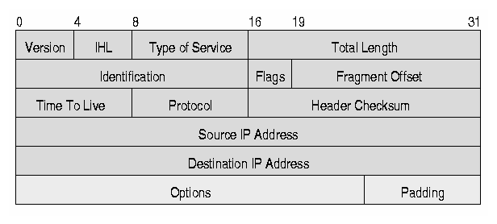
IP Datagram (Packet, Package)
Header
10101011101010101010010101010100101010100
11010010101010010101111111010000011101111
10100001011101010100110101011110100000101
00100000000010101000011010000111111010101
......... 1011011001010100011001001010110
Data

Slide 11
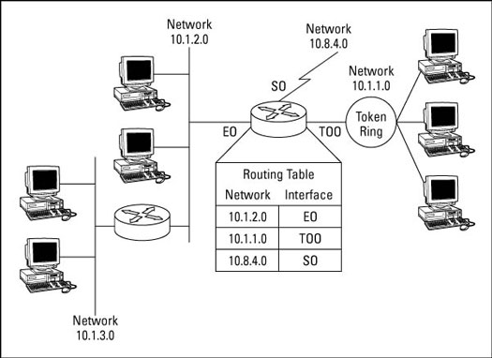
IP Route Table

Slide 12
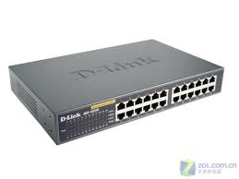
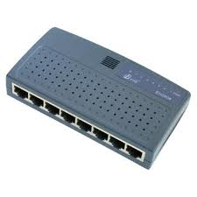

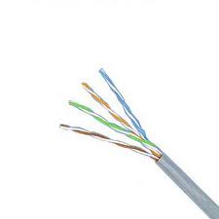
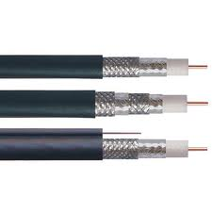
Link Layer (& Physical Layer)
Network entities
Hub, switcher, etc.
Twisted line, cable line, etc.
Name space
No name needed
Protocols
Ethernet, ATM, etc.
ARP, RARP, etc.
What to care?
Physical transfer, error detection, etc.

Slide 13
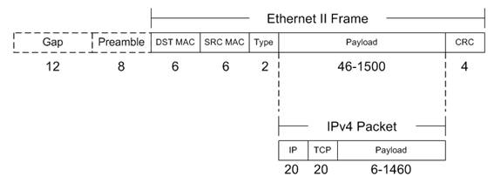
Frame Format of Ethernet

Slide 14
TCP/IP Architecture
Machine A
Machine B
Application
Application
Transport
Router/Gateway
Transport
Internet
Internet
Internet
Network Interface
Network Interface
Network Interface
Network 1
Network 2
Notes:
Transfer of information across networks through gateways/routers
Corresponding to OSI network layer: routing and congestion control
Global unique IP address and IP packets
Best-effort connectionless IP packet transfer: no setup, routed independently, robust, out of order, duplicate, or lose of packet

Slide 15
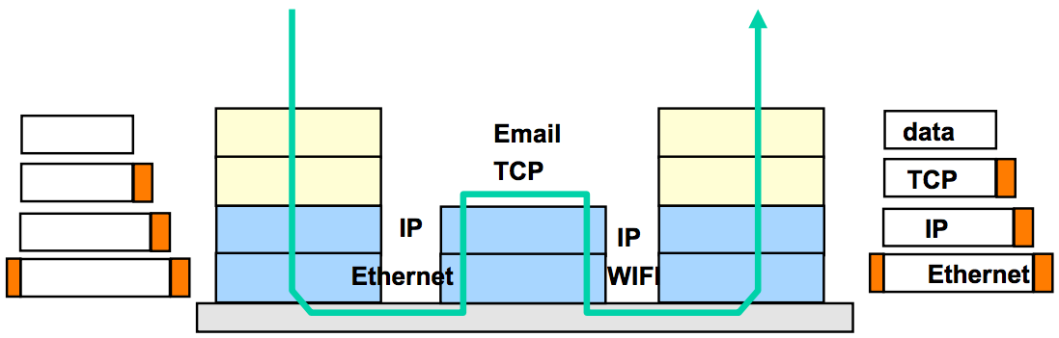
TCP/IP Architecture
Each layer adds/strips off its own header
Each layer may split up higher-level data
Each layer multiplexes multiple higher layers
Each layer is (mostly) transparent to higher layers

Slide 16
Link Layer
From a node to its physical neighbor

Slide 17
The Link Layer
The bottom-most layer of the three layers
Purpose: moving data directly from one physical location to another
1. Physical transmission
2. Multiplexing the link
3. Framing bits & bit sequences
4. Detecting transmission errors
5. Providing a useful interface to the up layer

Slide 18
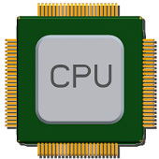
Physical Transmission using Shared Clock
Example-1: moving a bit from register-1 to register-2 on the same chip
Run a wire to connect output of reg-1 to input of reg-2
Wait till reg-1's output has settled & signal has propagated to reg-2
Reg-2 read input the next clock tick
Assumption: propagation can be done within one clock
How to send data between two modules without sharing a clock?

Slide 19
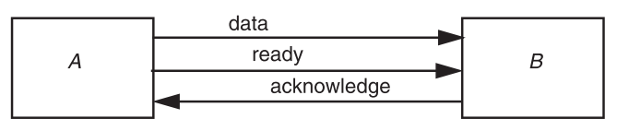
Physical Transmission without Shared Clock
Three-wire ready/acknowledge protocol
1. A places data on data line
2. A changes value on the ready line
B sees the ready line change, reads value on the data line, then changes the acknowledge line
B: when to look at the data line? (ready is set)
A: when to stop holding the bit value on the data line? (ack is set)

Slide 20
Parallel Transmission
Propagation time ∆t
It takes more than 2x∆t to send one bit
The max data rate is 1/(2∆t)
Parallel transmission
Use N parallel data lines to achieve N/(2∆t)
E.g., SCSI, printer, etc.

Slide 21
Serial Transmission
Ready/acknowledge protocol
∆t grows significantly, which limits the data rate
Serial transmission
Send a stream of bits down a single line
Without waiting for any response from the receiver
Expect the receiver can recover the bits with no additional signal
Higher rates, longer distance, fewer wires
E.g., USB, SATA

Slide 22
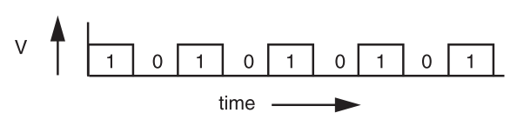
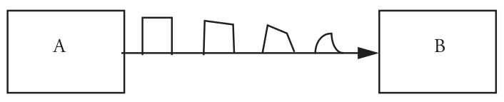
Signal Transmission on Analog Line
It is hard for B to understand the signal
B doesn't have a copy of A's clock, so when to sample the signal?

Slide 23
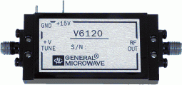
VCO: Voltage Controlled Oscillator
How to make two ends agree on the data rate without clock line?
The receiver run a VCO at about the same data rate
VCO's output is multiplied by the voltage of incoming signal
The product is suitably filtered and sent back to adjust the VCO
VCO will finally be locked to both the frequency and phase of the arriving signal: phase-locked loop
Then the VCO becomes a clock source for the receiver
Problem: if no transition in the stream (e.g., a lot of zero), the phase-locked loop cannot synchronize

Slide 24
Manchester Code
Solution: sender encodes the data to ensure transitions
Phase encoding: at least 1 level transition for a bit
Manchester code: 0 -> 01, 1 -> 10
Max data rate is only half, but simple enough
1
0
1
0
1
1
1
0
0
Polar NRZ
Manchester
Encoding

Slide 25
How to Share a Connection?
Isochronous communication (telephone communication)
Needs prior arrangement between switches
Connection: set up and tear down
Stream: continuous bits flows out of a phone
Asynchronous communication (data communication)
Message: burst, ill-suited to fixed size and spacing of isochronous frames
Connectionless, asynchronous

Slide 26
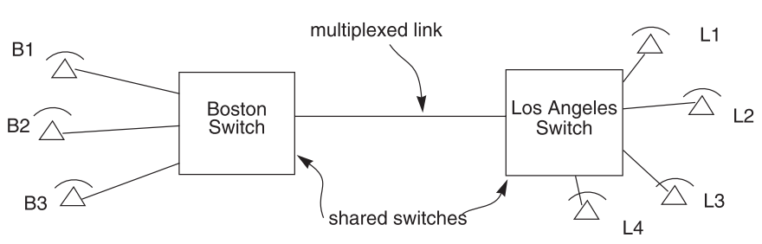
Isochronous Multiplexing
Telephone network
Leverage "virtual link" for connection
"network is busy" when no available time slot

Slide 27
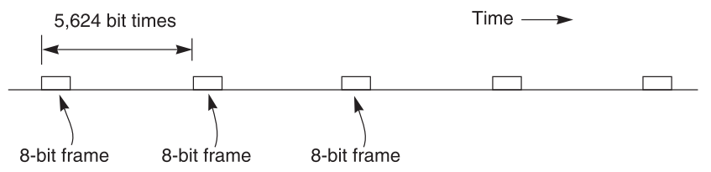
Isochronous - TDM
64 Kbps each phone, 45 Mbps link
8-bit block (frame), 8000 frames per second
5624 bit times or 125 us
703 simultaneous conversations (what if there is a 704th calling?)
Q: Why the voice is still continuous, instead of fragmented?

Slide 28
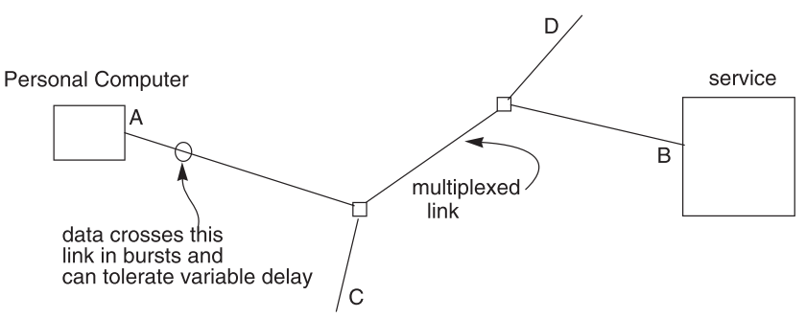
Data Communication Network
Data communication network usually contains burst communication
Different from the telephone network

Slide 29
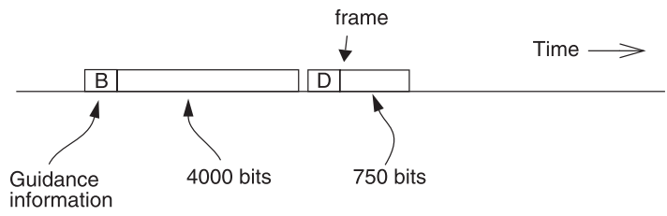
Frame and Packet: Asynchronous Link
Frame can be of any length, carried at any time that the link is free
Packet: a variable-length frame with its guidance info
Connectionless transmission: no state maintained
Segment and reassemble
Packet voice: replacing many parts of isochronous network

Slide 30
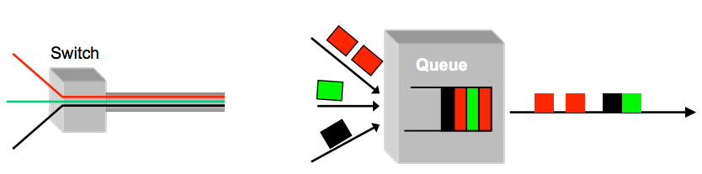
Multiplexing / Demultiplexing
Switch
Multiplex using a queue: switch need memory/buffer
Demultiplex using information in packet header
Header has destination
Switch has a forwarding table that contains information about which link to use to reach a destination

Slide 31
Framing Frames
Where a frame begins and ends
Independent from framing bits
Some model separates link layer to 2: one for bits and one for frames
Simple method
Choose a pattern of bits, e.g., 7 one-bits in a row, as a frame-separator
Bit stuffing: if data contains 6 ones in a row, then add an extra bit (0)

Slide 32
Error Handling
Error detection code
Adding redundancy: e.g., checksum at the end
What to do if detect an error
Error correction code: with enough redundancy
Where noise is well understood, e.g., disk
Ask sender to resend: sender holds frame in buffer
Let receiver discard the frame
Blending these techniques

Slide 33


Coding: Incremental Redundancy
Forward error correction
Perform coding before storing or transmitting
Later decode the data without appealing to the creator
Hamming distance
Number of 1 in A ⊕ B , ⊕ is exclusive OR (XOR)
If H-distance between every legitimate pair is 2
000101, can only detect 1-bit flip
If H-distance between every legitimate pair is 3
Can only correct 1 bit flip
If H-distance between every legitimate pair is 4
Can detect 2-bit flip, correct 1-bit flip

Slide 34
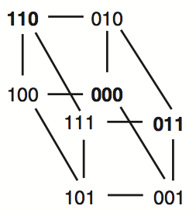
Example-1: Simple Parity Check
2 bits -> 3 bits
Detect 1-bit errors
8 patterns total
Only 4 correct patterns
00 -> 000
11 -> 110
10 -> 101
01 -> 011
Hamming distance of this code is 2
1-bit flipping will cause incorrect pattern

Slide 35
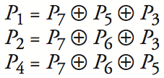
Example-2: 4-bit -> 7-bit
4 bits -> 7 bits (56 using only extra 7)
3 extra bits to distinguish 8 cases
e.g. 1101 -> 1010101
Correct 1-bit errors
1010101 -> 1010001 : P1 & P4 not match
1010101 -> 1110101 : P2 not match
Not Match | Error
None | None
P1 | P1
P2 | P2
P4 | P4
P1 & P2 | P3
P1 & P4 | P5
P2 & P4 | P6
P1 & P2 & P4 | P7
1 2 3 4 5 6 7
1
0
1
0
1
0
1
1
0
1
0
1
0
1
1
0
1
0
1
0
1

